Slide 1
Insurance Broking Game
Avani Kottalgi, 2021A7PS0049U
Joel Joseph, 2021A7PS0063U

Slide 2

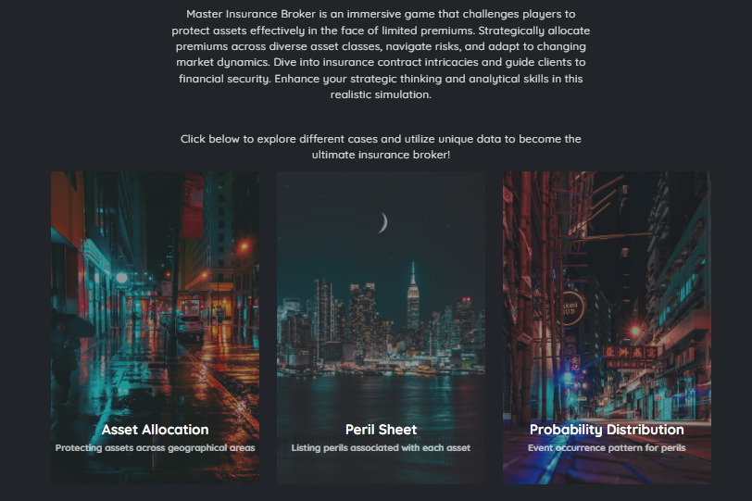
Main goal of the game
Each team starts the game with an amount of 5% of the total asset value with which they can purchase risk protection across various asset classes.

Slide 3
Languages used for creating
HTML and CSS for frontend
PHP for linking frontend with backend
phpMyAdmin for backend ( using MYSQL commands )

Slide 4
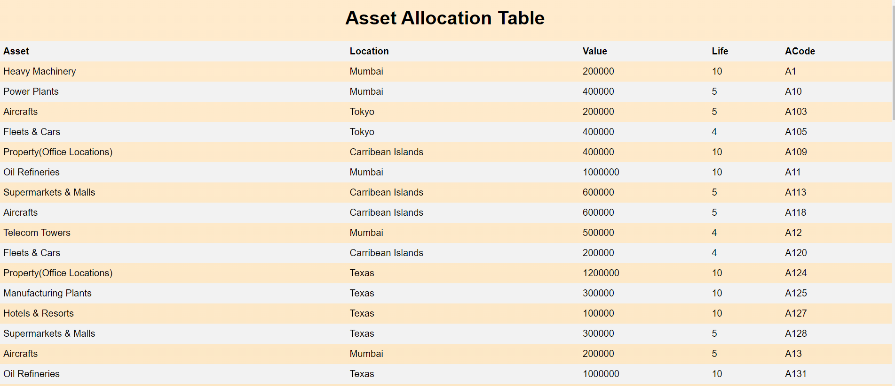
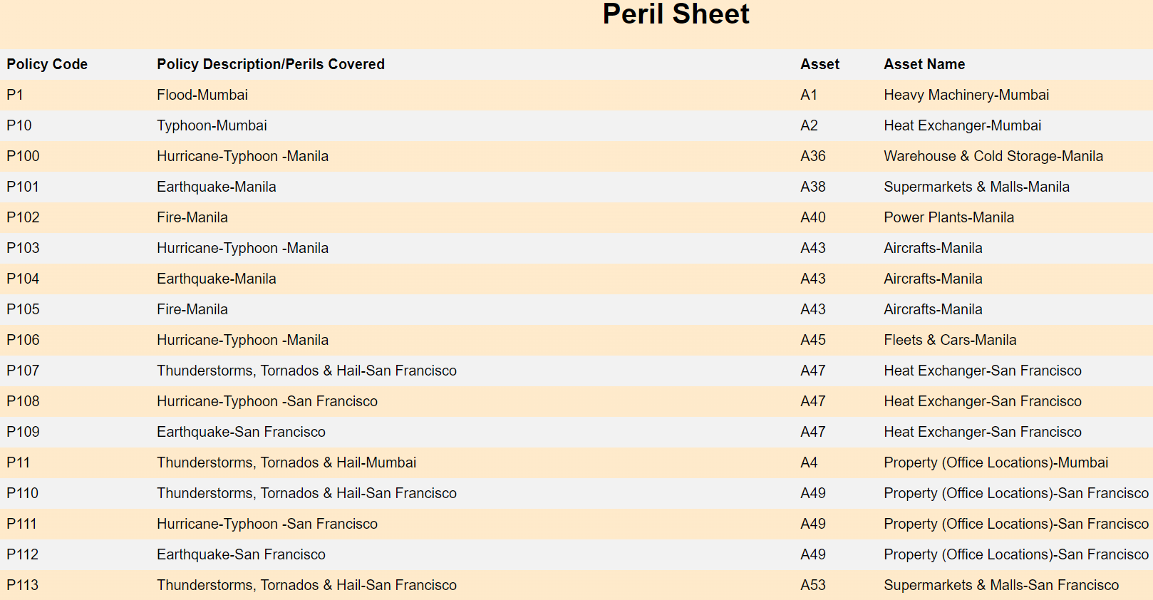
Page where users can view the data

Slide 5
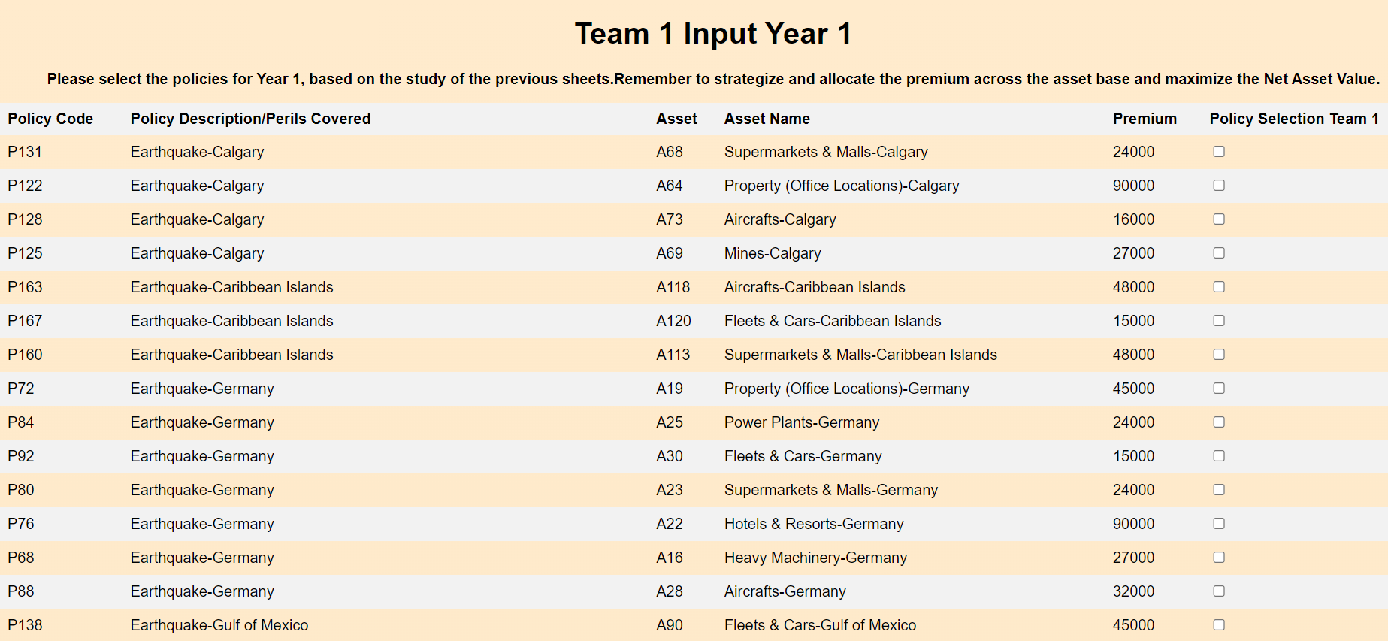
Input Page where Users can choose their Policies

Slide 6
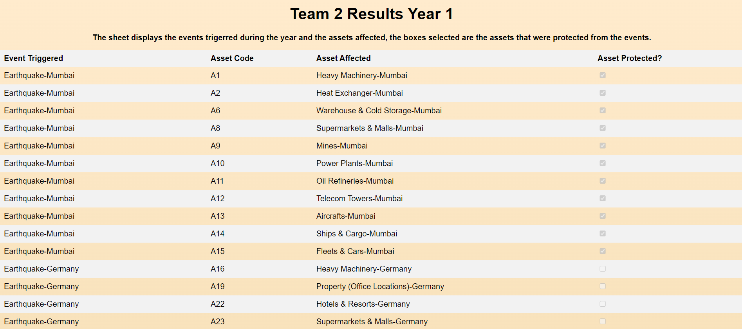
Results Page where the user can see if his/her Assets were Protected from the Risk Events

Slide 7
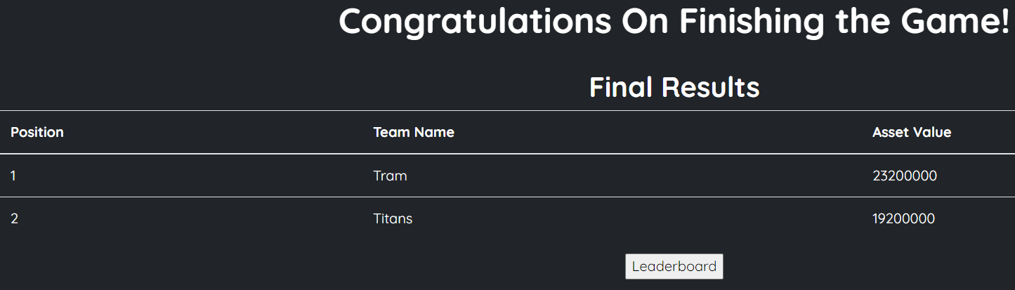
The team with the most asset value after three rounds wins!
Ss of leaderboard page

